Slide 1
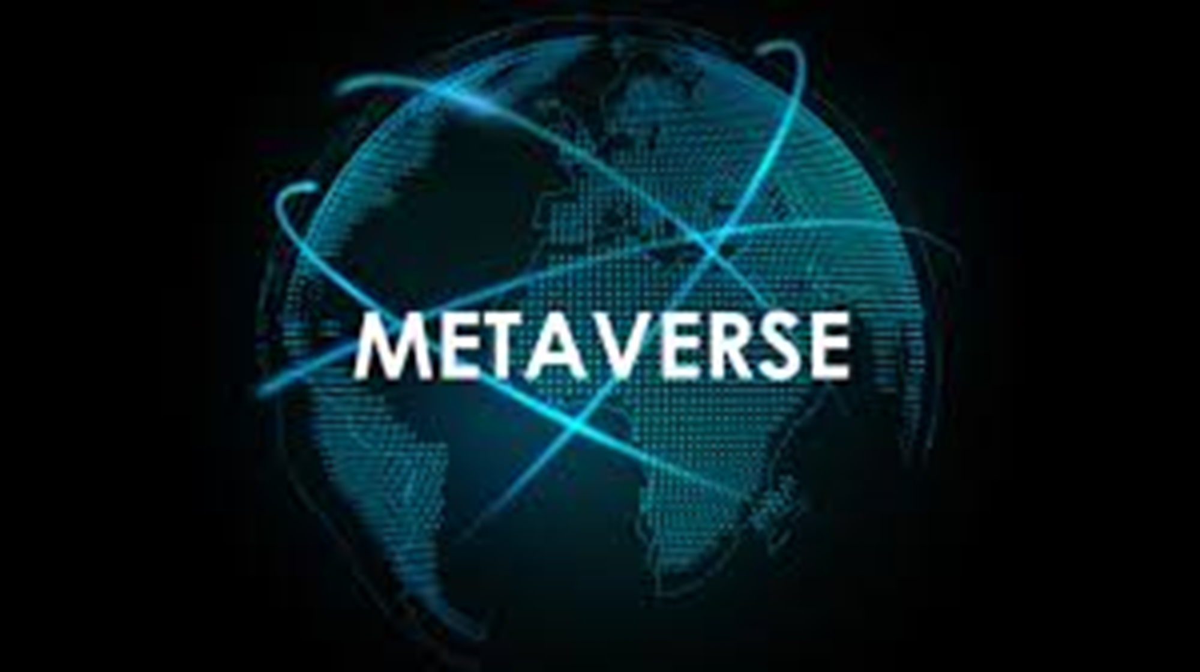
BY: MUHAMMAD KASHIF MAJEED ROLL NO. PIAIC18348 BATCH: 38

Slide 2
WHAT IS METAVERSE?
The metaverse is a concept of a persistent, online, 3D universe that combines multiple different virtual spaces. You can think of it as a future iteration of the internet. The metaverse will allow users to work, meet, game, and socialize together in these 3D spaces.
The concept was developed in the science-fiction novel Snow Crash by Neal Stephenson. However, while the idea of a metaverse was once fiction, it now looks like it could be a reality in the future.

Slide 3
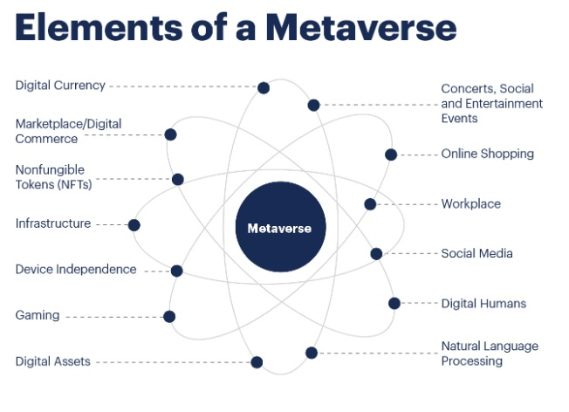

Slide 4
What are the business opportunities of a Metaverse?
Today there are many individual use cases and products, all creating their own versions of a Metaverse. Opportunities across multiple industries include:
Higher education, medical, military and other types of trades can deliver a more immersive learning experience. They don’t need to create their own infrastructure, as the Metaverse will provide the framework.
Virtual events, having gained popularity over the last two years, can now present more integrated offerings.

Slide 5
Retail can extend its reach to an immersive shopping experience that allows for more complex products.
Enterprises can achieve better engagement, collaboration and connection with their employees through virtually augmented workspaces.
Social media can move to the Metaverse, where users can interact through three-dimensional avatars.

